Slide 1
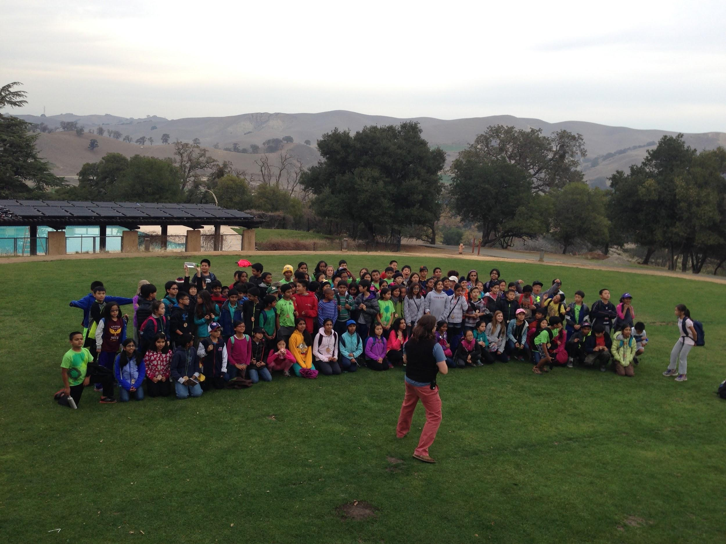

Slide 2
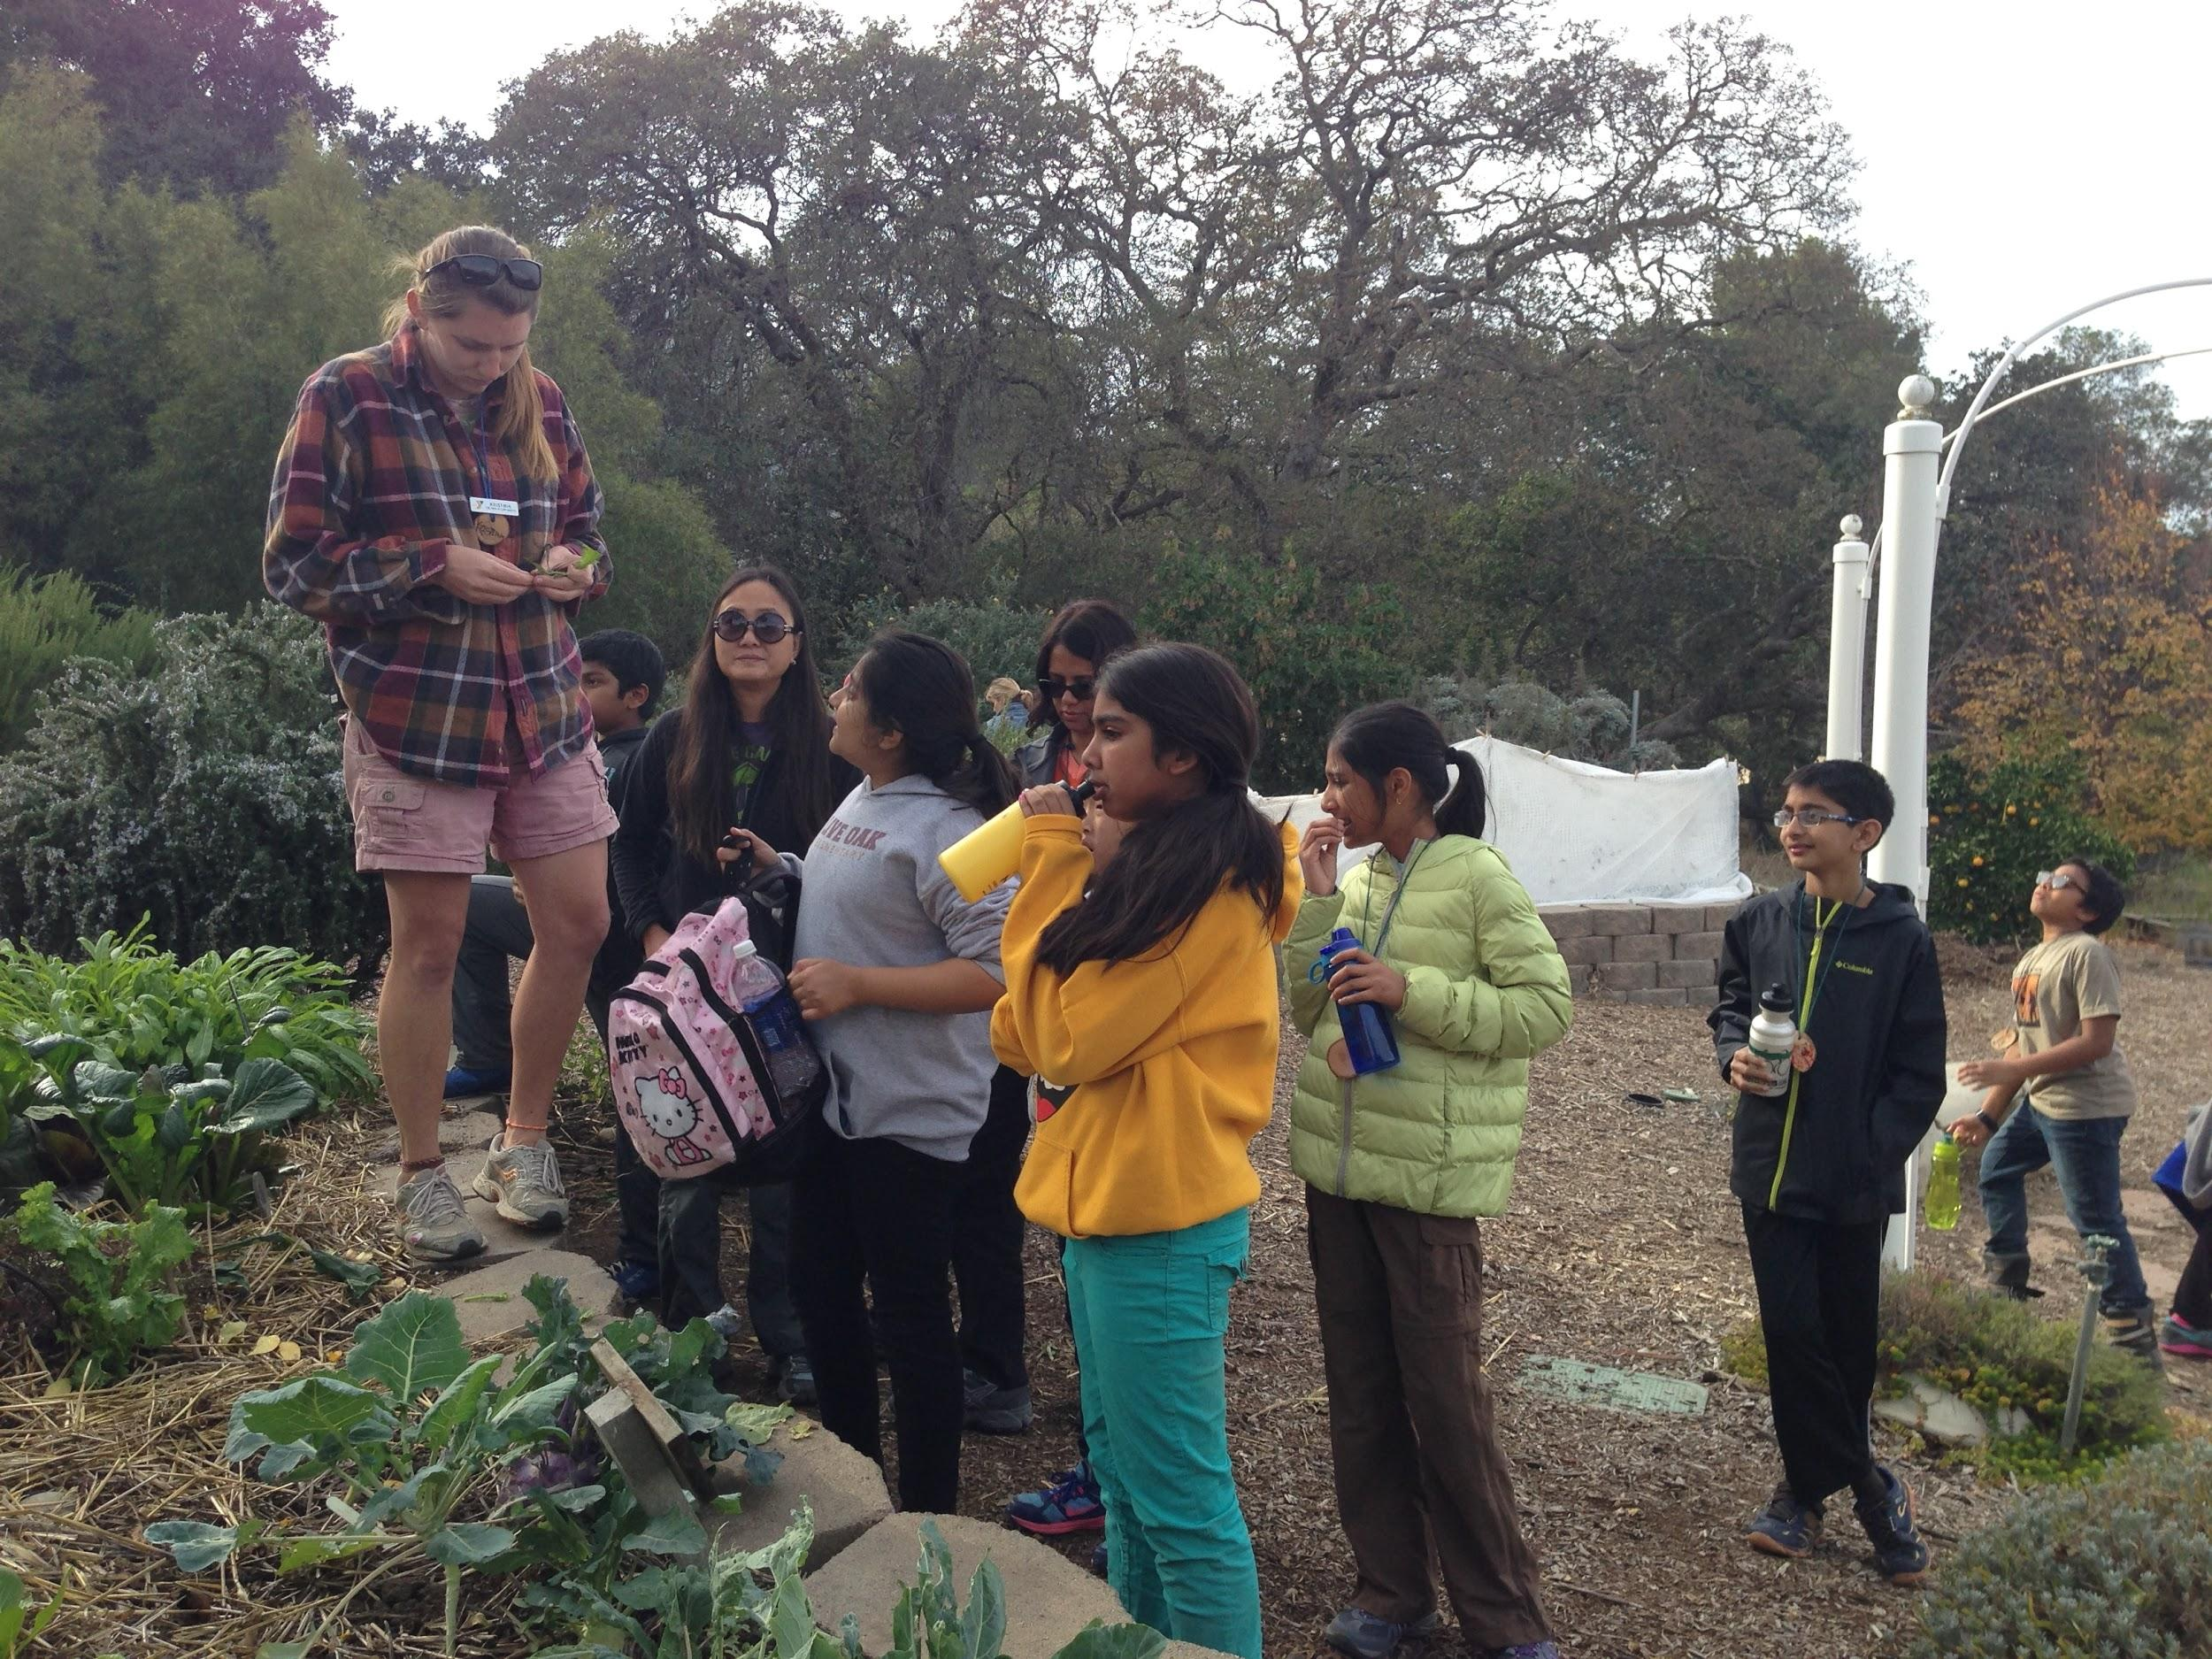
Camp Arroyo
Live Oak- 5th Grade
Explore. Learn. Grow

Slide 3
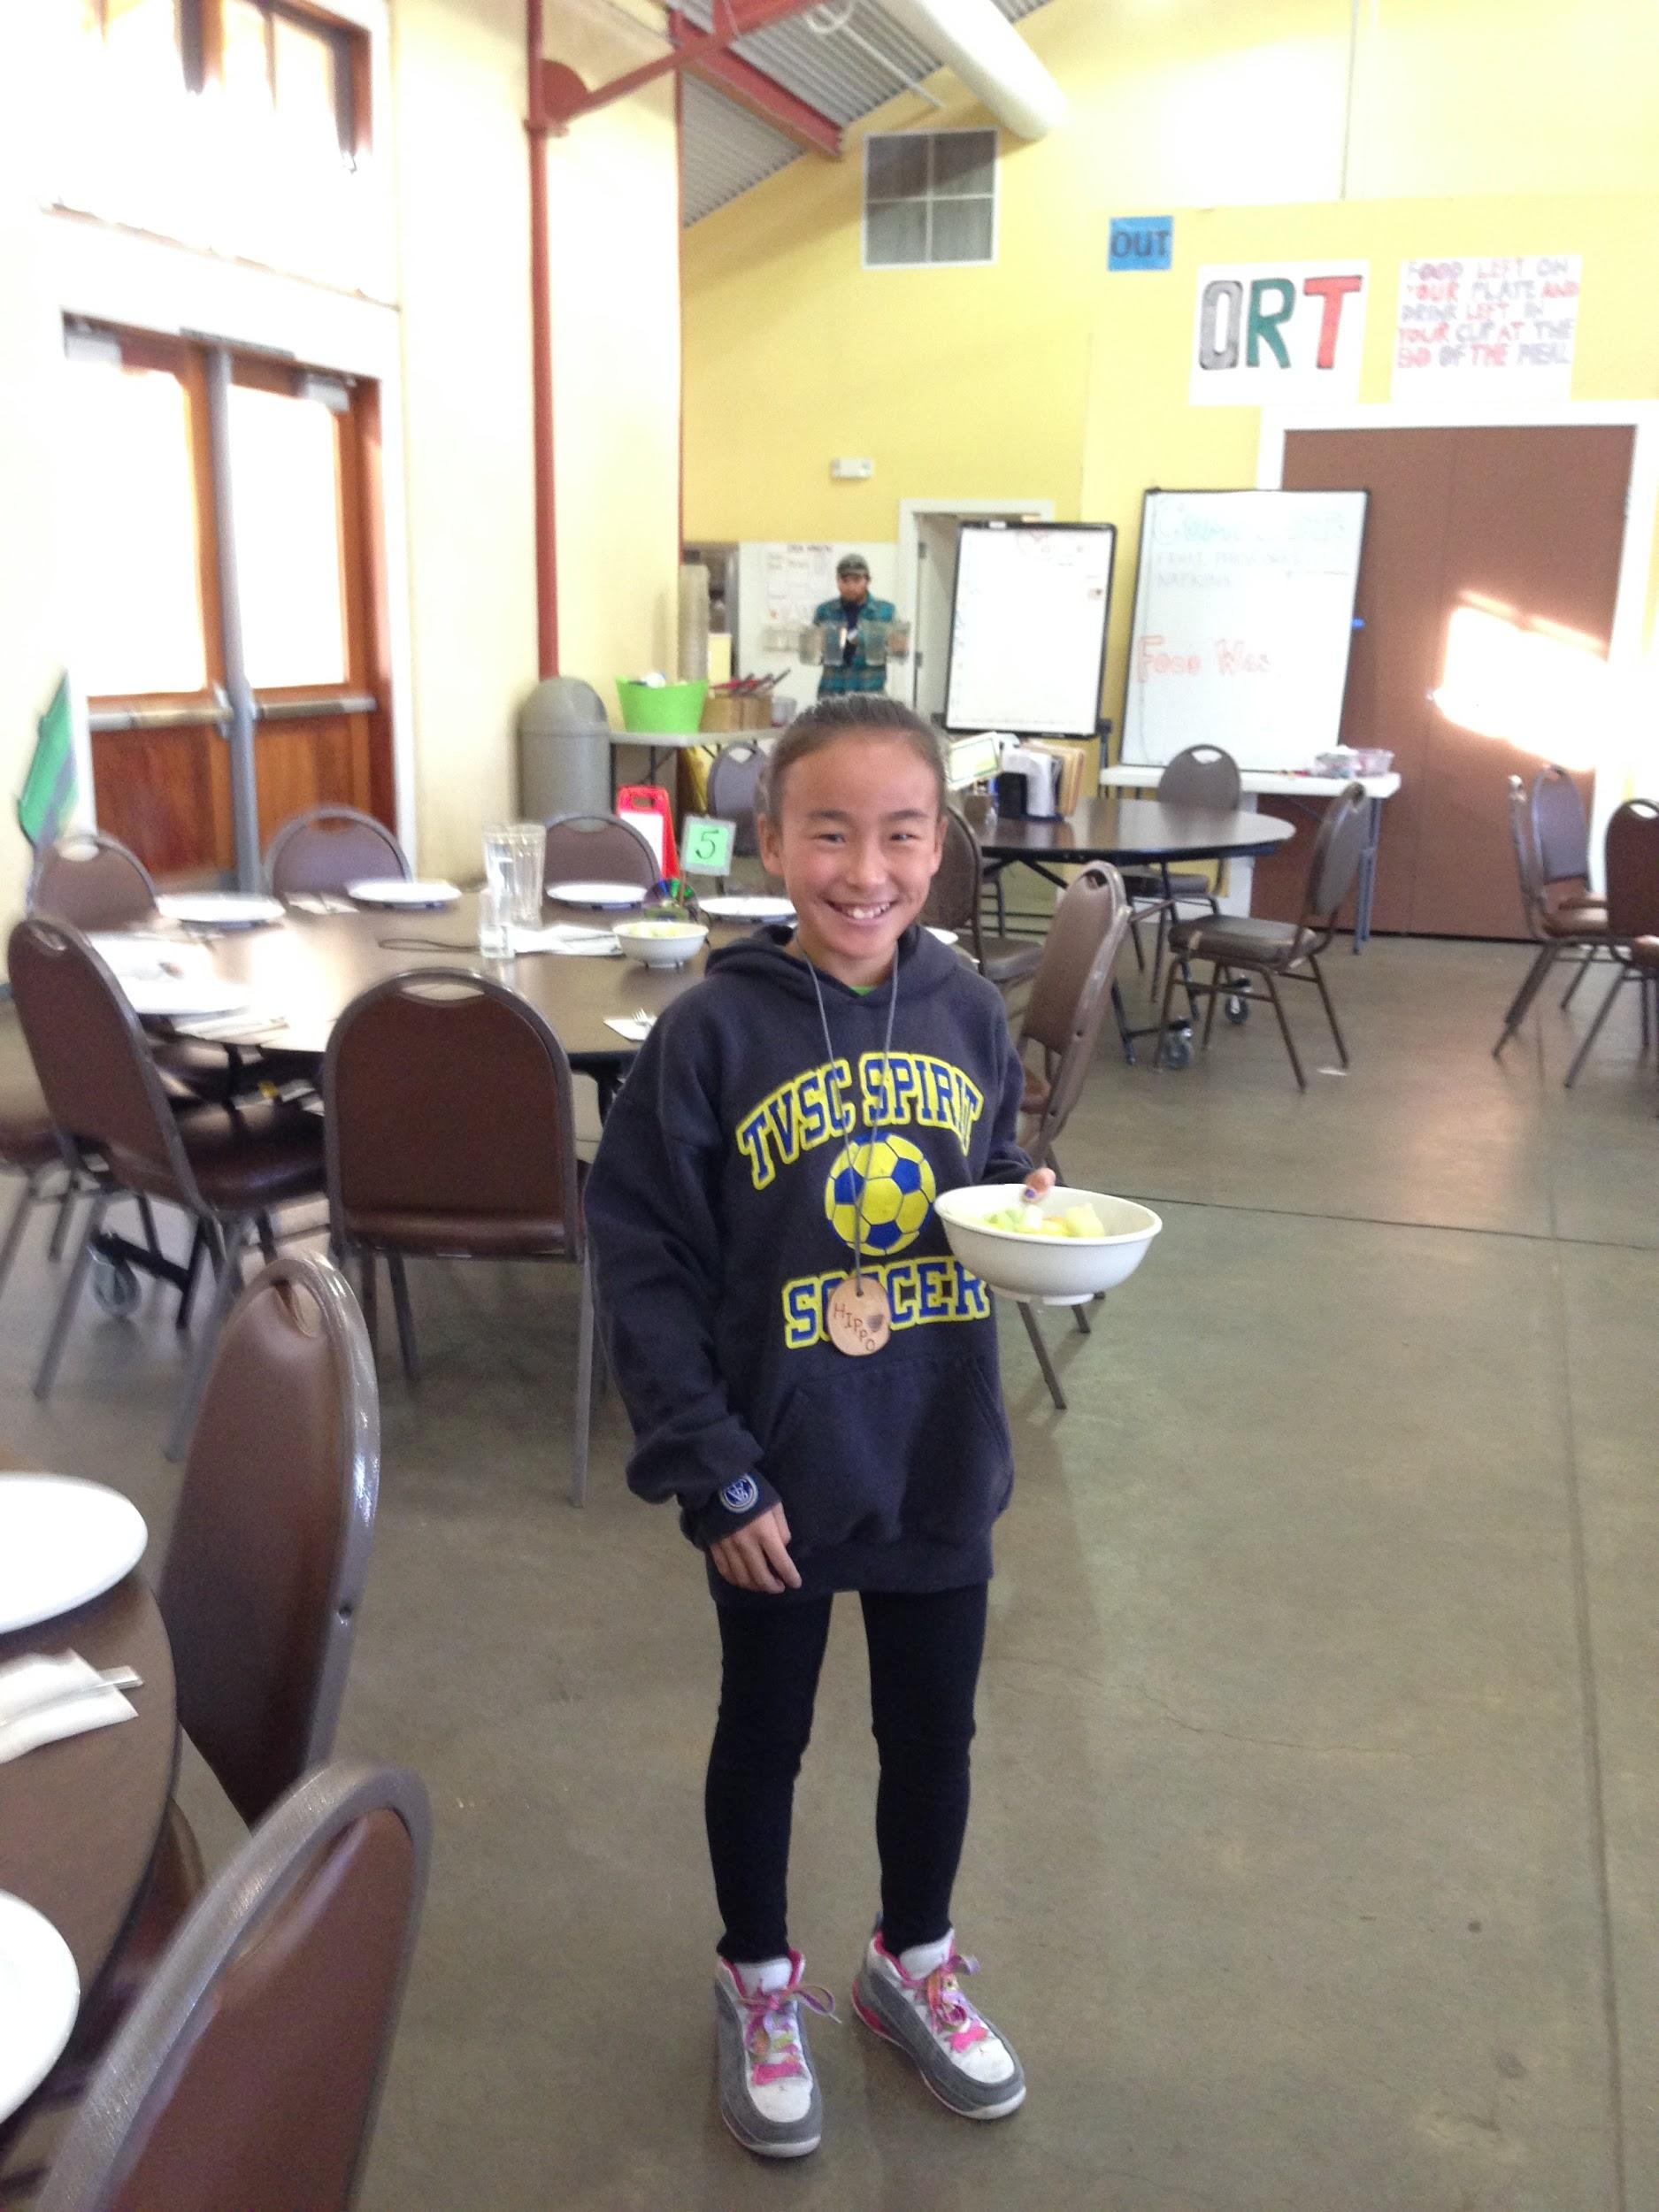
A highlight of camp was “Observing how the camp enabled the kids to be independent, disciplined and have fun at the same time!”
~An Experienced Chaperone

Slide 4
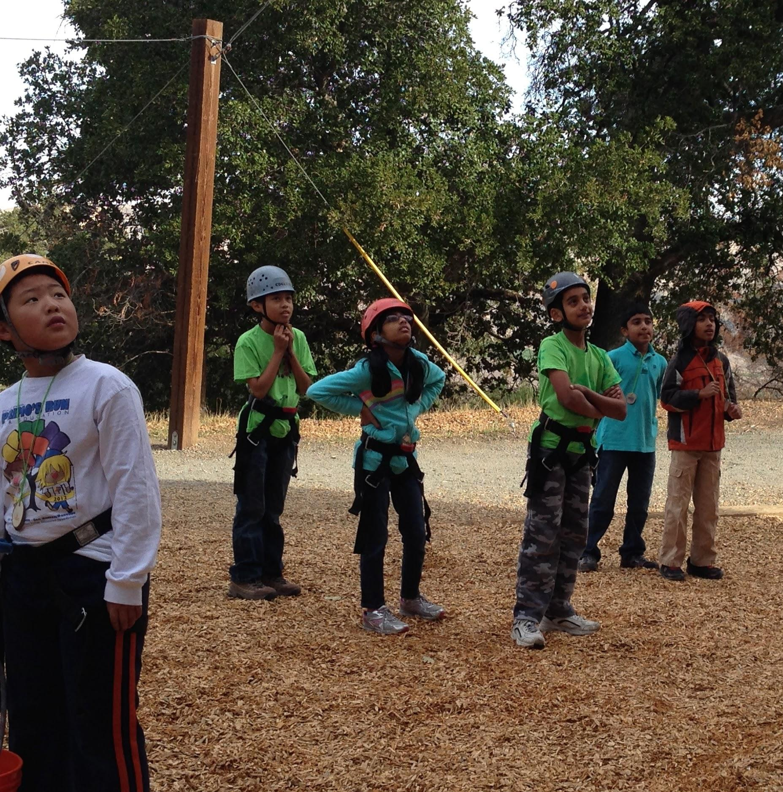
Camp was “Well organized, good mixture of fun for students with outdoor activities and outdoor class learning with basic life skills and discipline.” ~ 2014 -2015 Chaperone/Dad

Slide 5
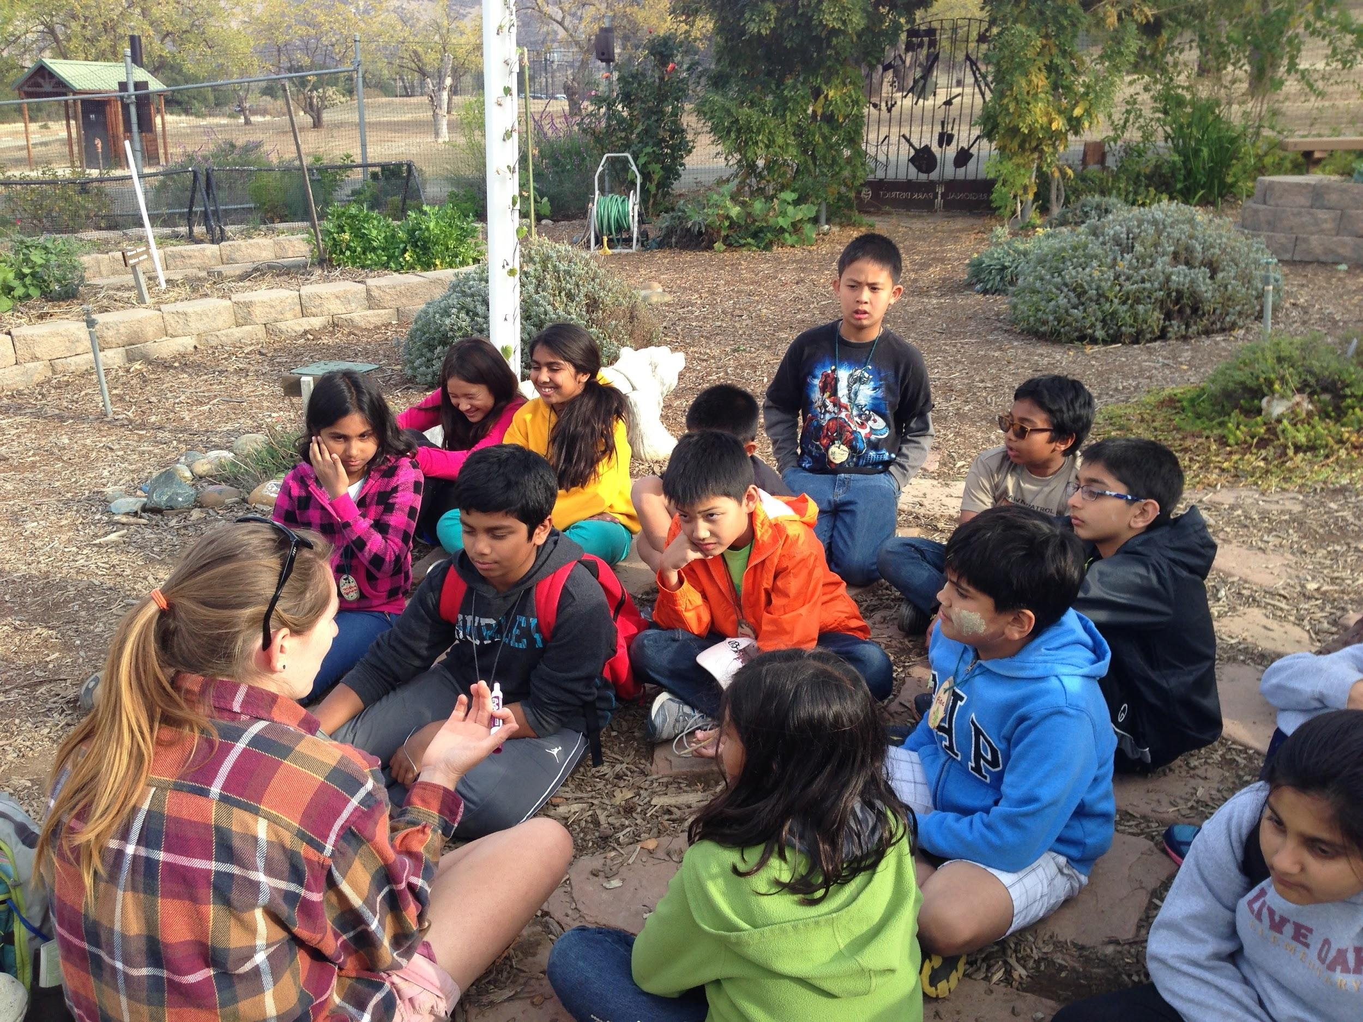
“I also enjoyed seeing my son in his ‘natural’ environment around his schoolmates.”

Slide 6
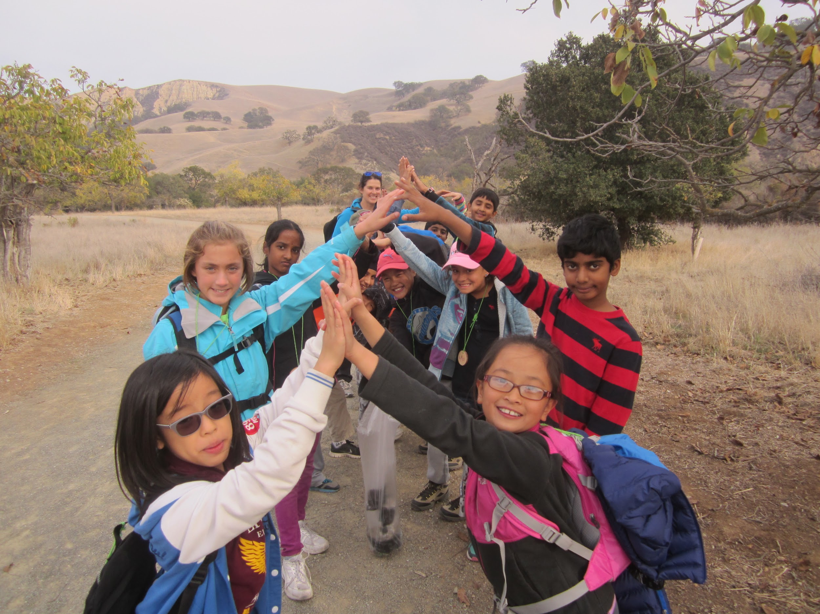
“The naturalists seemed genuinely engaged with the kids and the activities.”

Slide 7
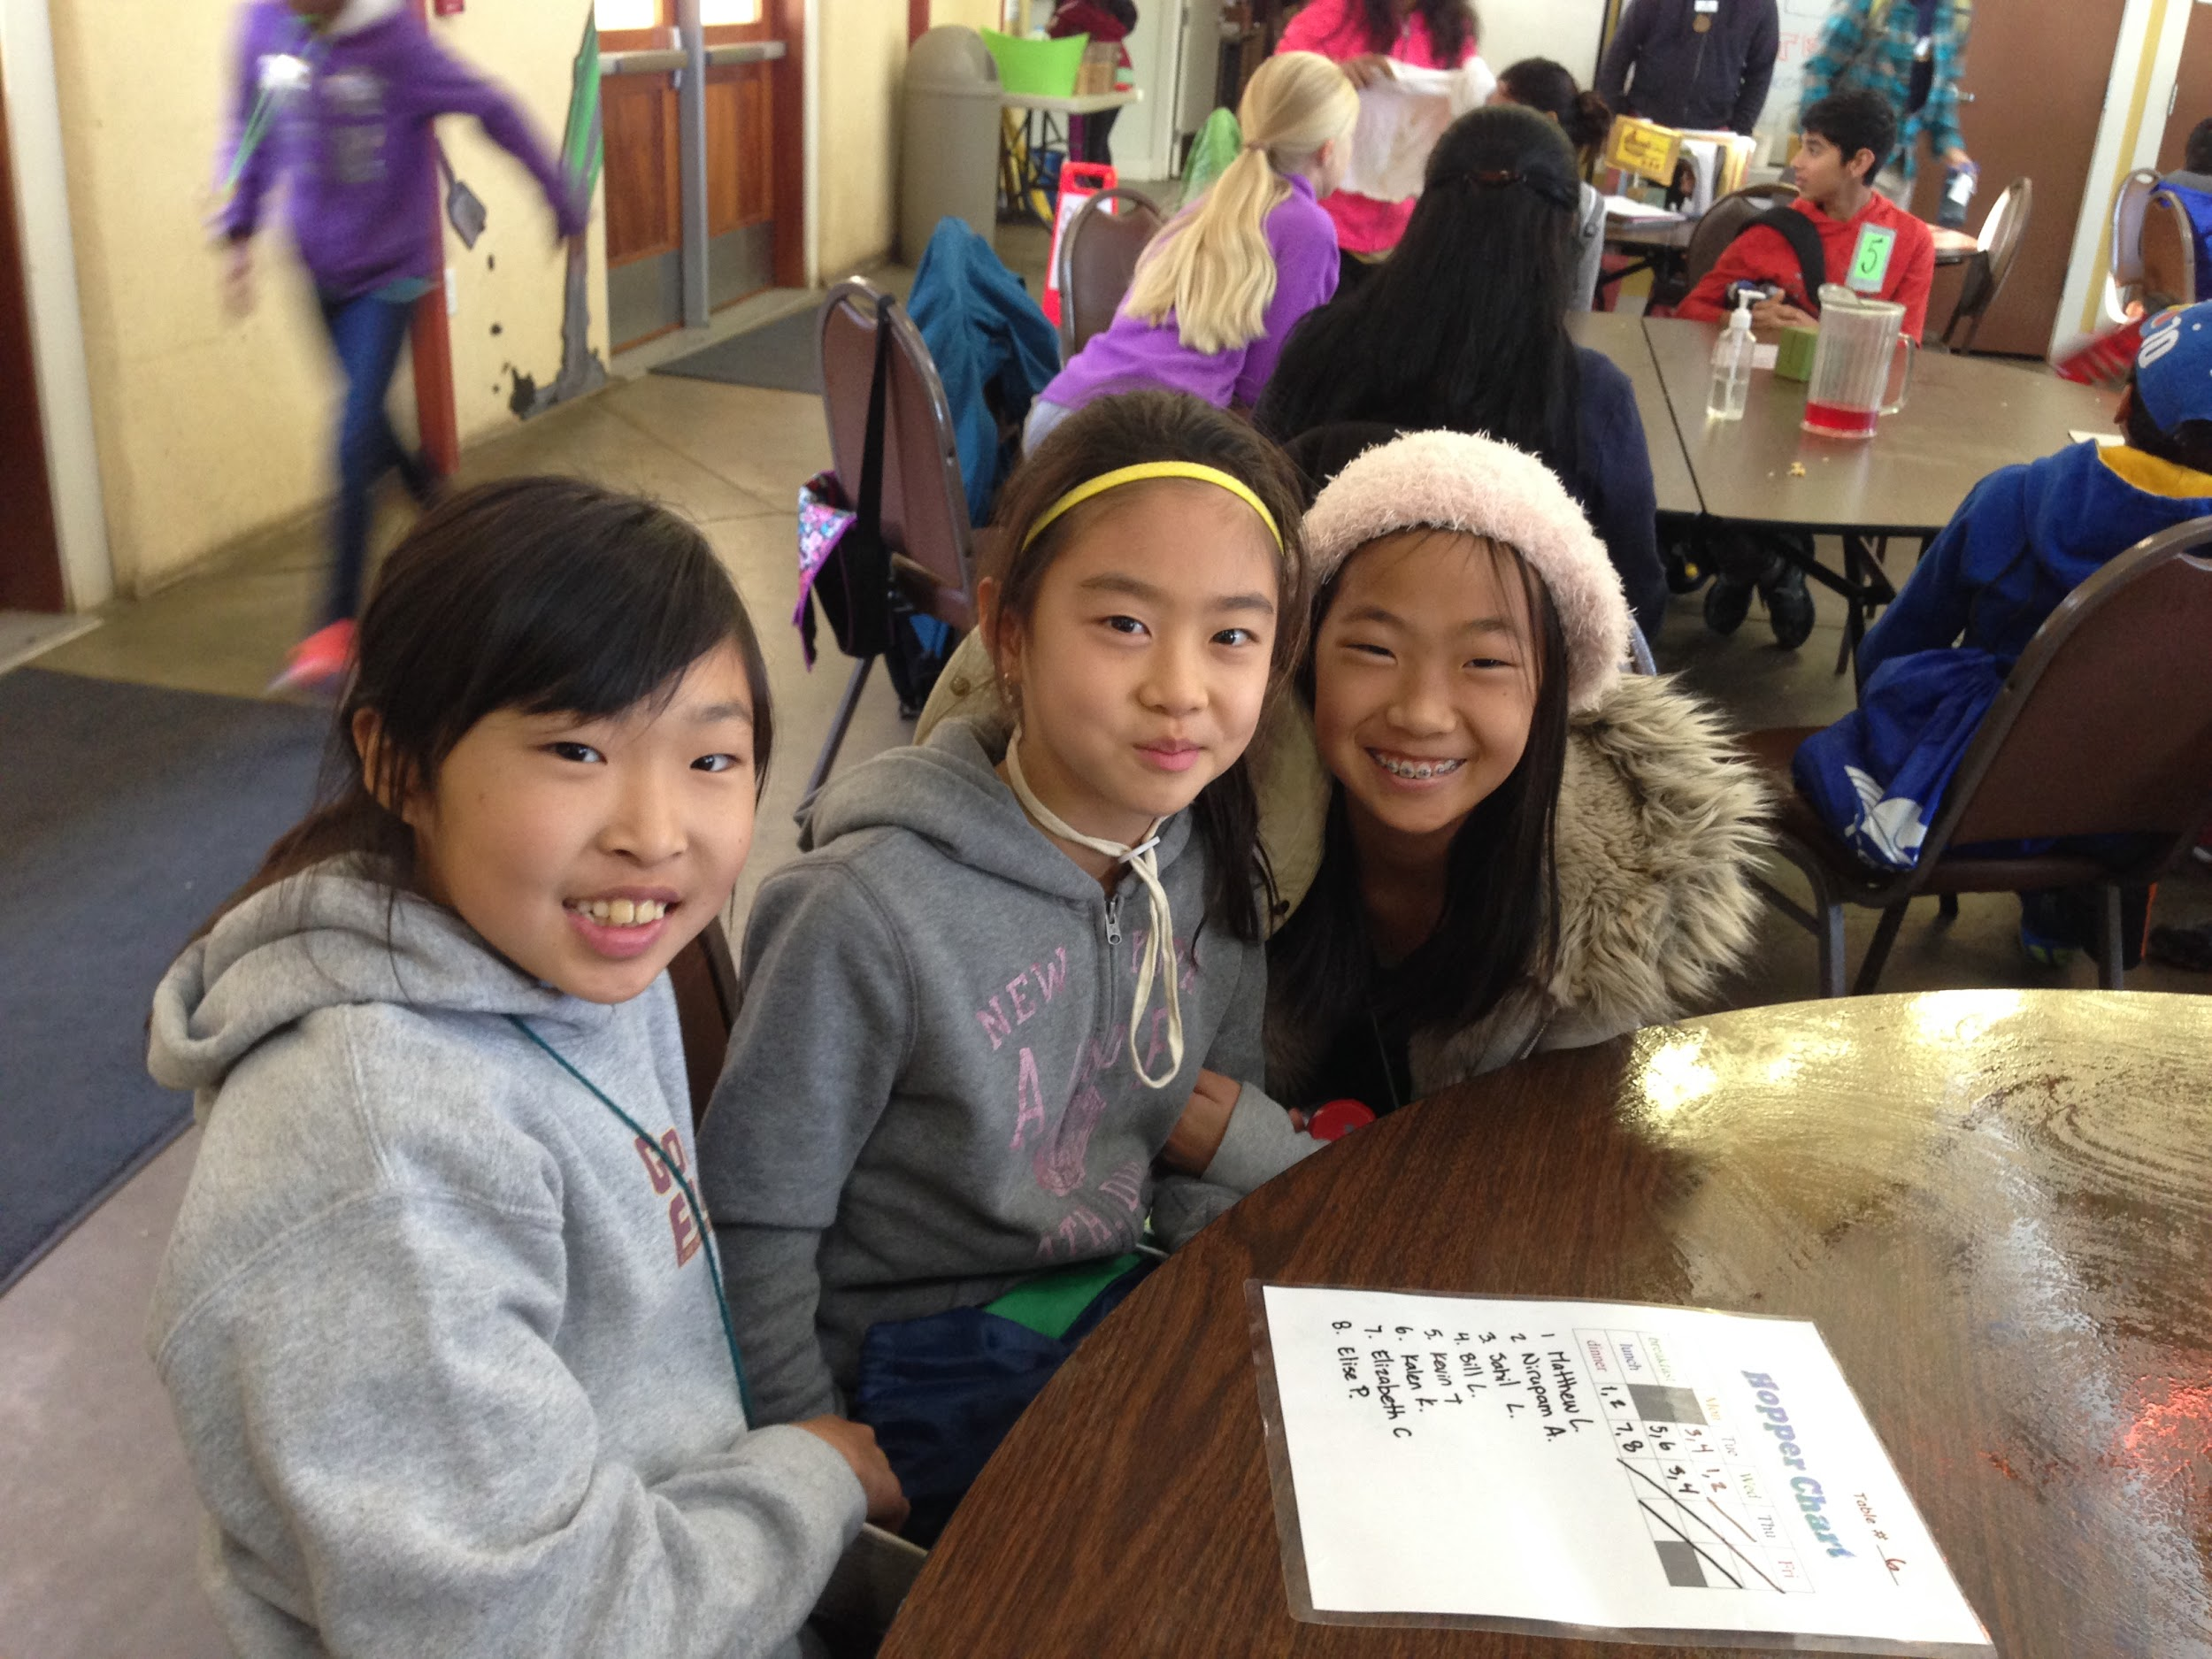
Dates
Group A November 26-28
Group B November 28-30
*Thanksgiving Break is November 19-23*
**Teachers do not know when they will be going**

Slide 8
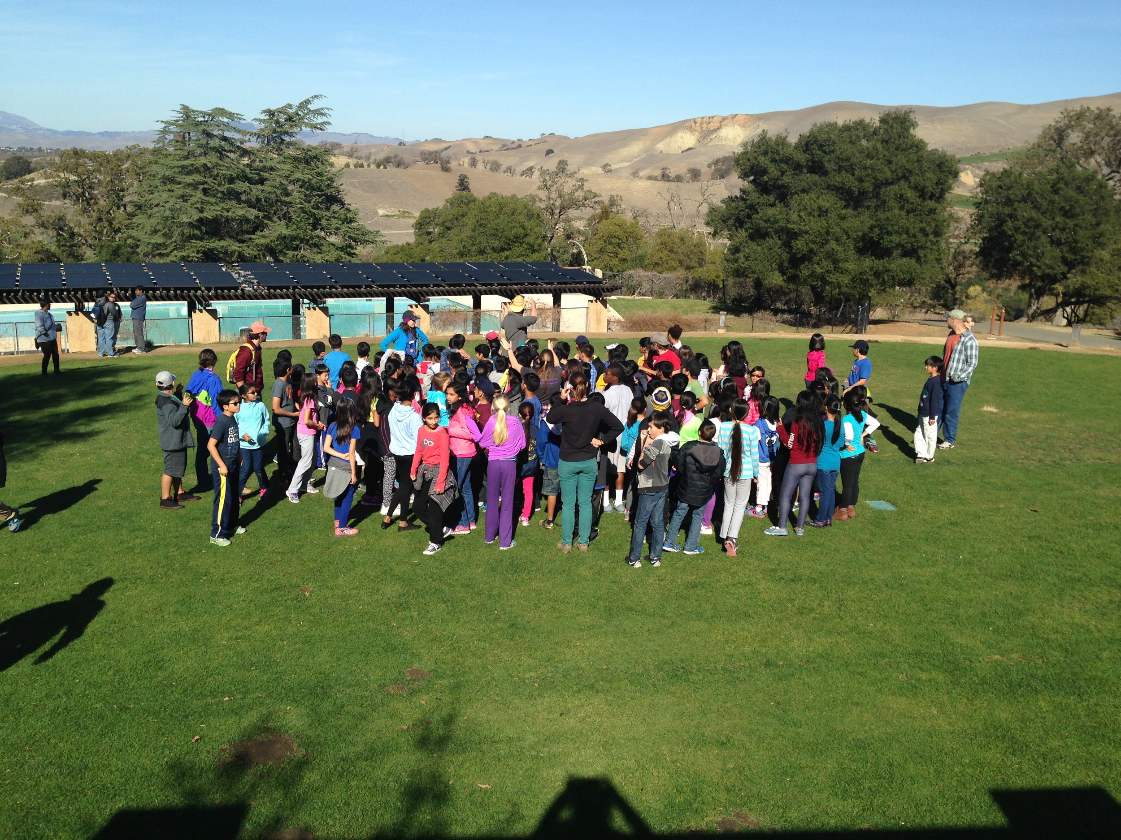
Cost
$280 per student ($140 deposit by September 14; Final payments due October 12)
Cost is covered for approved chaperones
Cost includes lessons, meals, accommodations while at camp

Slide 9
Chaperone Info
Interested? We need you! We can’t go
without your help!
All chaperones must have their Be a
Mentor clearance with LEVEL 3 clearance. Please initiate your clearance process ASAP.
(Level 1 and 2 must also be cleared)
Purpose of camp is to develop independence of all campers
Camp is EXTREMELY supportive of all students’ needs-dietary, health, religious

Slide 10
Brief Overview of
Camp
Three days, two nights in
Livermore, CA
This is a science-based
outdoor education
Students participate in daily
adventures, hikes, lessons with a Naturalist
They complete chores and help with set-up and cleanup for all meals
Students are supervised at ALL times
Teachers stay on site

Slide 11
How can you help?
Allow your student to attend!!
Give your student household chores!
Build confidence being away from home- allow your child to have a sleepover at a friend or relative’s house without you!
Continue your independence building activities throughout the summer

Slide 12
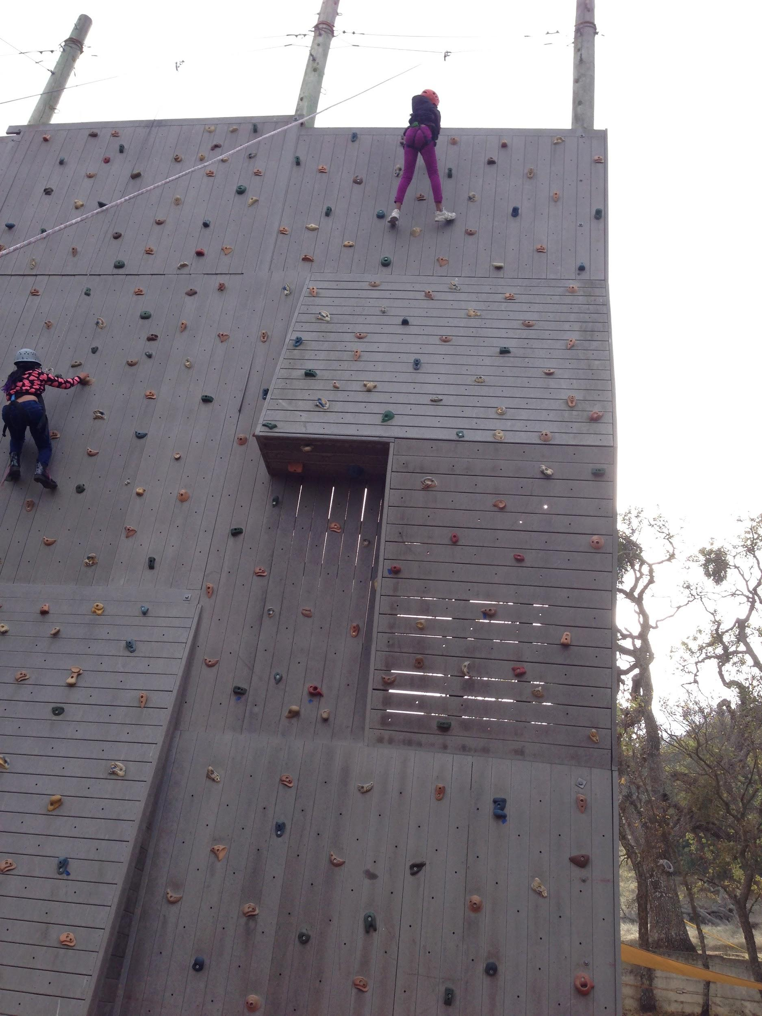
Thank you for joining us!
More information to be discussed in the Fall at
Back-to-School Night!
Any questions? Please contact our principal.

Slide 13
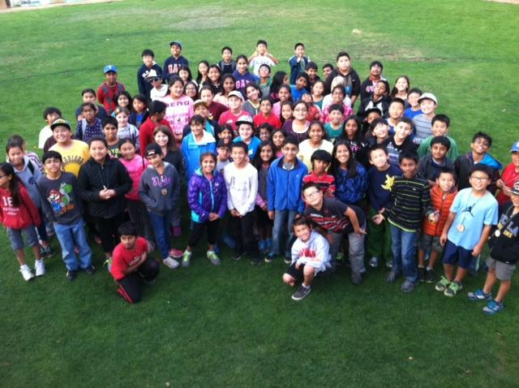
Camp Arroyo is the best!!

